Slide 1
Figure 2. Semi-quantitative RT-PCR analysis of UBQ expression profile in leaf under heat treatment at 0, 0.5, 2 and 4 h (indicated by arrow).
This image was flipped horizontally in Fig.2 so that the samples were in chronical orders.
heat
4 2 0.5 0

Slide 2
Figure 2. Semi-quantitative RT-PCR analysis of UBQ expression profile in leaf under ABA (50μM) treatment at 0, 0.5, 2 and 4 h (indicated by arrow).
ABA
0 0.5 2 4

Slide 3
Figure 2. Semi-quantitative RT-PCR analysis of UBQ expression profile in leaf under drought and salt treatment at 0, 0.5, 2 and 4 h (indicated by arrow).
drought
salt
0 0.5 2 4
0 0.5 2 4

Slide 4
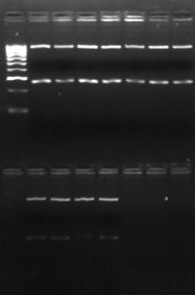
Figure 2. Semi-quantitative RT-PCR analysis of UBQ expression profile in root under different treatment (indicated by arrow).
Salt 0h Drought ABA 0h
4h 4h 4h
The images of 0h - 4h after salt treatment, 0h - 4h after ABA treatment were cropped and flipped horizontally in Fig. 2 so that the samples were in chronical orders.

Slide 5
Figure 2. Semi-quantitative RT-PCR analysis of AsHSP26.8a expression profile in leaf under heat treatment (gel on the left indicated by arrow) at 0, 0.5, 2 and 4 h, and in root (gel on the right, indicated by arrow) 4 h after salt (S), heat (H), drought (D) or ABA (A) treatment. The “0” in gel on the right indicates treatment at 0 h.
root
0 0.5 2 4
leaf
S 0 H 0 D 0 A

Slide 6
Figure 2. Semi-quantitative RT-PCR analysis of AsHSP26.8a expression profile in leaf (left) under salt, drought and ABA treatment (indicated by arrows).
No band was detected in all the images (no gene expression).
salt
0 0.5 2 4
drought
0 0.5 2 4
ABA
0 0.5 2 4

Slide 7
Figure 3. Generation and molecular analysis of the AsHSP26.8a transgenic (TG) Arabidopsis thaliana
WT TG6 TG5 TG4 TG3 TG2 TG1
AsHSP26.8a
Two images of Fig. 3B were flipped horizontally so that transgenic lines were in ascending order according to their numbers (from left to right).
Genomic DNA
WT TG6 TG5 TG4 TG3 TG2 TG1
Bar
TG1 TG2 TG3 TG4 TG5 TG6 WT
AsHSP26.8a
Genomic DNA
cDNA

Slide 8
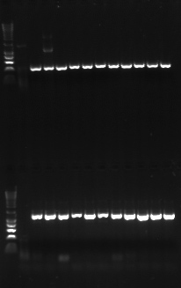
Figure 3C. Actin expression in transgenic (TG) Arabidopsis thaliana. The data included in the figure 3C are highlighted in the red square.
X gene TG lines
AsHSP26.8a TG lines
CK WT
WT
TG1 TG2 TG3 TG4 TG5 TG6

